Slide 1


Quality Assurance
Kampala, Uganda

Slide 2
Quality Assurance
Errors and warnings
JOSM validation tool
Common validation warnings
Conflict Resolution
Using filters
Optical analysis

Slide 3
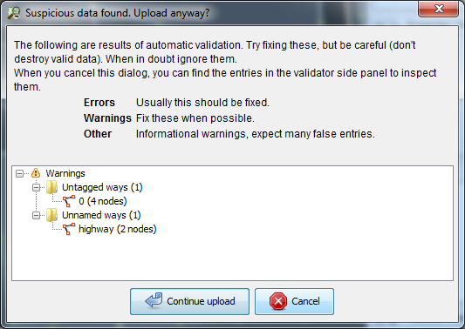
Errors and warnings
Sometimes when you go to upload your edits in JOSM you get a pop-up window like this:

Slide 4
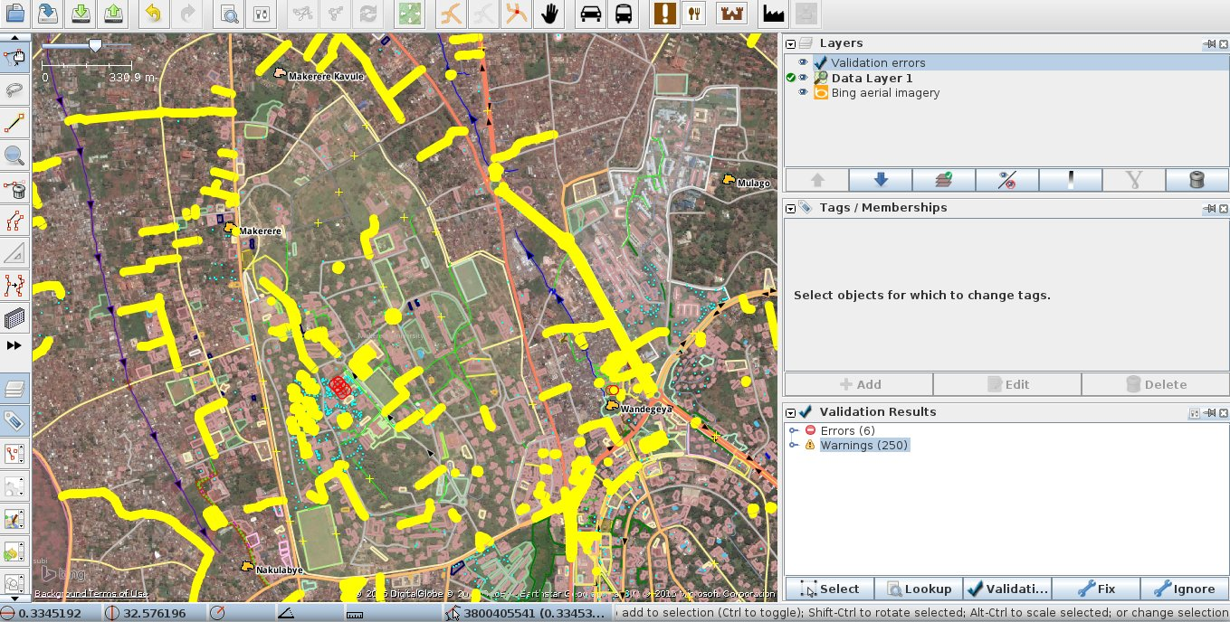
JOSM validation tool
Click the validation tool in the Validation Results window to perfom data validation

Slide 5
Errors and warnings (Cont’d)
Errors: These are important to fix, and therefore usually you should not ignore these. Examples of errors include duplicated objects or overlapping lines and polygons.
Warnings: These are problems that are important to fix, but in some cases, they are tolerable.

Slide 6
JOSM validation tool (Cont’d)
Errors should almost always be fixed. Zoom to an error by right-clicking on it in the window and selecting Zoom to Problem, then fix the problem
If you select a warning from the list and decide that it is not a problem, click Ignore and it will be removed from the list.
If you download a large area of the map and run the validation tool, you may get a very long list of errors and warnings. You may see mistakes that other mappers have made, and you can fix them, or ignore them.

Slide 7

Common validation warnings
Ways that are not closed
This is usually a line that does not form a polygon.
Common examples are buildings where the first node does not meet the last node.
To fix this, select both nodes and go to Tools ‣ Merge Nodes to connect them.

Slide 8
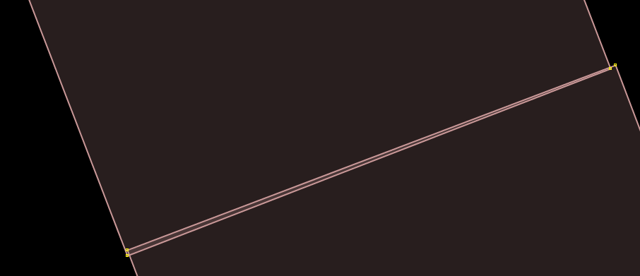
Common validation warnings
Crossing buildings (overlapping buildings)
To fix this, move the nodes of one of the buildings outside of the other building.

Slide 9
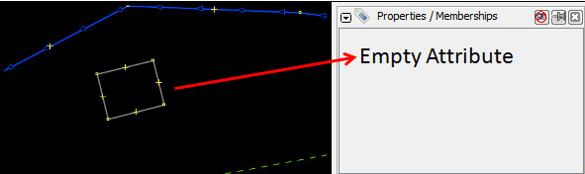
Common validation warnings
Untagged notes or ways
If someone draws a point or a line but forgets to give it any tags, then it is useless, because it does not mean anything.
To fix this, apply tags to the object to identify it, or delete it if it is a mistake.

Slide 10
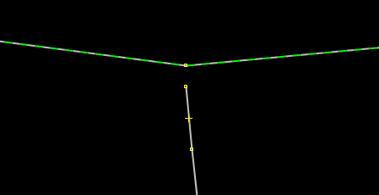
Common validation warnings
End node near another way
If a line ends very close to another line but does not connect, this raises a warning.
To fix this, select the nodes and go to Tools ‣ Join Node to Way to connect them.

Slide 11
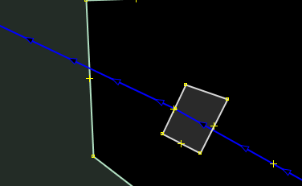
Common validation warnings
Crossing ways
Lines that cross other lines without being connected will raise warnings.

Slide 12
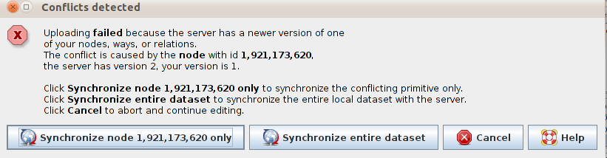
Conflict resolution
When working with JOSM and about to upload changes, sometimes we encounter this message:
This happens when two download a group of data that includes a particular point at the same time, making changes to it and upload it back to OSM.

Slide 13
Conflict resolution
Best option: avoid conflicts: upload data often, in small portions
(at least once every 15 minutes!)
If a conflict happens while uploading:
Find the person whose data you’re conflicting with
Figure out what’s happening
In short, TALK

Slide 14
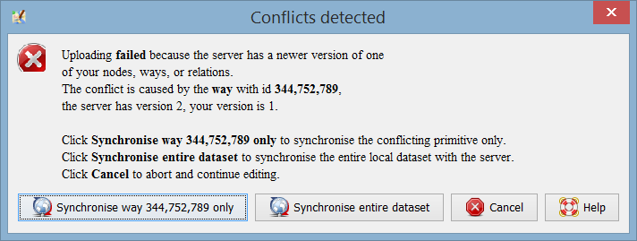
Conflict resolution
Be conservative! When given the choice, and you’re not sure, choose the other party’s data (which is already on the server)

Slide 15
Using Filters
Filters allow you to disable, hide, select, and highlight specific groups of objects based on flexible custom parameters.
Using filters helps you to spot and avoid common mistakes, review data and progress of work.

Slide 16
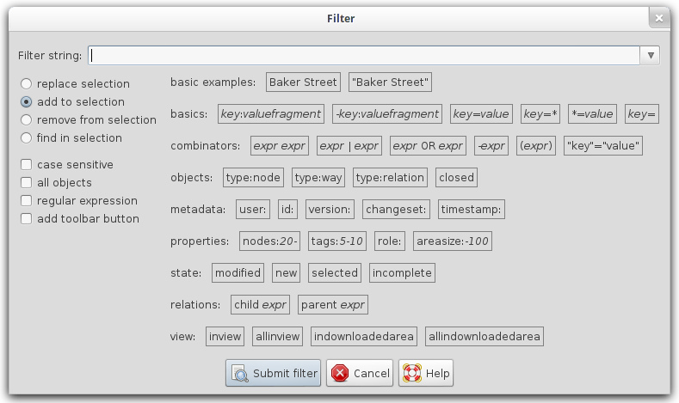
Adding filters
To work with filters, turn on the filters panel then use +Add button to create a new filter.

Slide 17
Filters
Filter | Purpose
waterway=* | natural=wetland | Focus on the drainage network, very useful for targeted analysis.
highway=* | Focus on the road network, very useful for targeted analysis.
building=* | Focus on the buildings.
building=* & (-building\:levels | -building\:material) | Find any buildings that don’t have either the ‘building:levels’ or the ‘building:material’ tag.
building=* & addr\:housenumber & -addr\:street | Find any buildings that have a house number, but lack a street name.

Slide 18
Filters (2)
Filter | Purpose
building=* & type:node | Find nodes that are tagged as building; this sometimes occurs due to uncareful selection.
natural=tree & name=* | Trees with a name. Most of the times, this should be put into ‘species:en’.
width:[A-Za-z] | height:[A-Za-z] | diameter:[A-Za-z] | Find any ‘width’, ‘height’ or ‘diameter’ attribute that has letters in it, often a unit. This was a common mistake in the first weeks.
timestamp:2015-04-15/ timestamp:2015-04-01/2015-04-12 | Focus only on the data for a particular day (or the defined timeframe)

Slide 19
Optical analysis
Look at the map closely…
Are there any double buildings?
Footways that don’t connect to roads?
Things with a name that should be in another key (trees, buildings, etc)
Secondary/tertiary ways that don’t connect to a road network?
Strangely shaped buildings?
Crossing roads without a node to connect them?
Overlapping building?
Untagged ways?

Slide 20
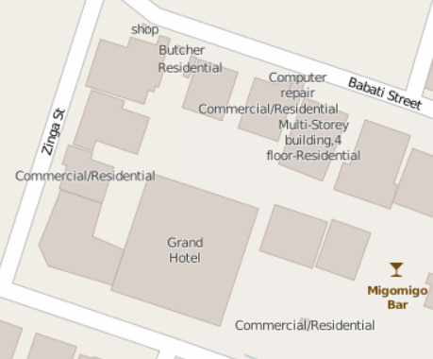
Common mistakes: ‘name’ tag
Using the “name” tag when it shouldn’t
(here, “building=type”, “amenity=service” and “building:levels=4”)

Slide 21
Names and capitalization
Good:
DJ Mrisho Records, Rama Garage, Feti Cafe
Bad:
DJ MRISHO records, MUSIC SHOP, Peace and love Pub, Feti cafe

Slide 22
Names and capitalization
Good:
Bombo Road, William Street, Masaka Road
Bad:
Burton street, market street
Avoid:
Abbreviations like Mt., St., Str for Street

Slide 23
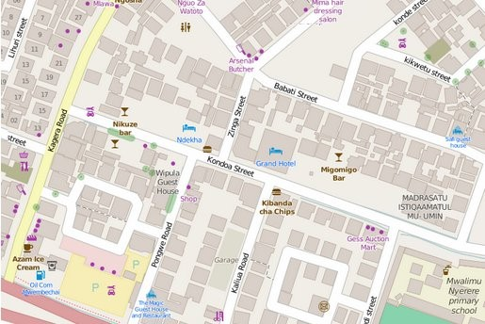
Names and capitalization

Slide 24
Common mistakes: mapping trees
Good:
species:en=coconut
Bad:
name=Coconut Tree

Slide 25
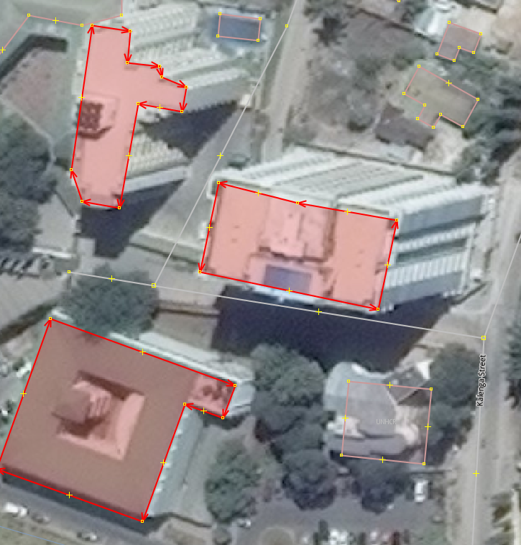
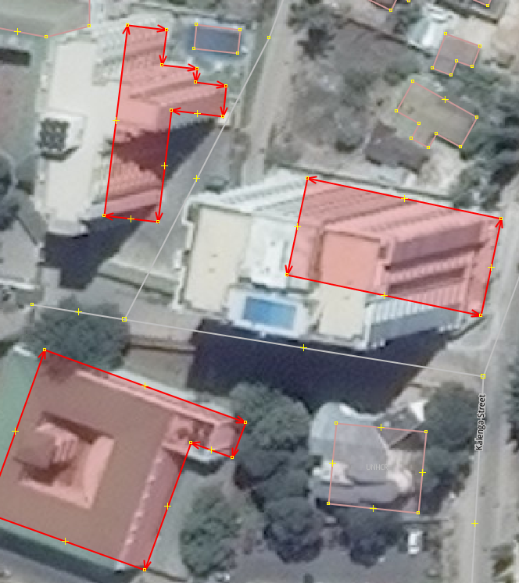
Common mistakes: top of building
Wrong: Correct:

Slide 26
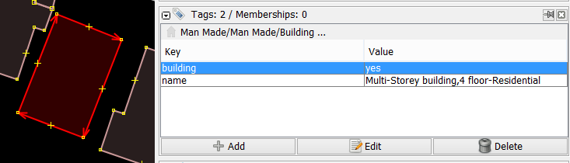
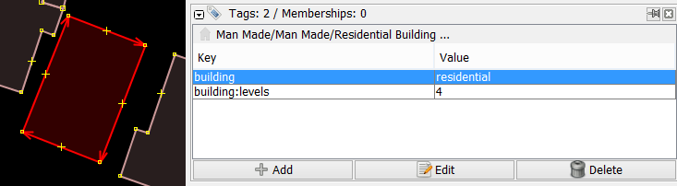
Building=yes, no levels, should not have a name

Slide 27
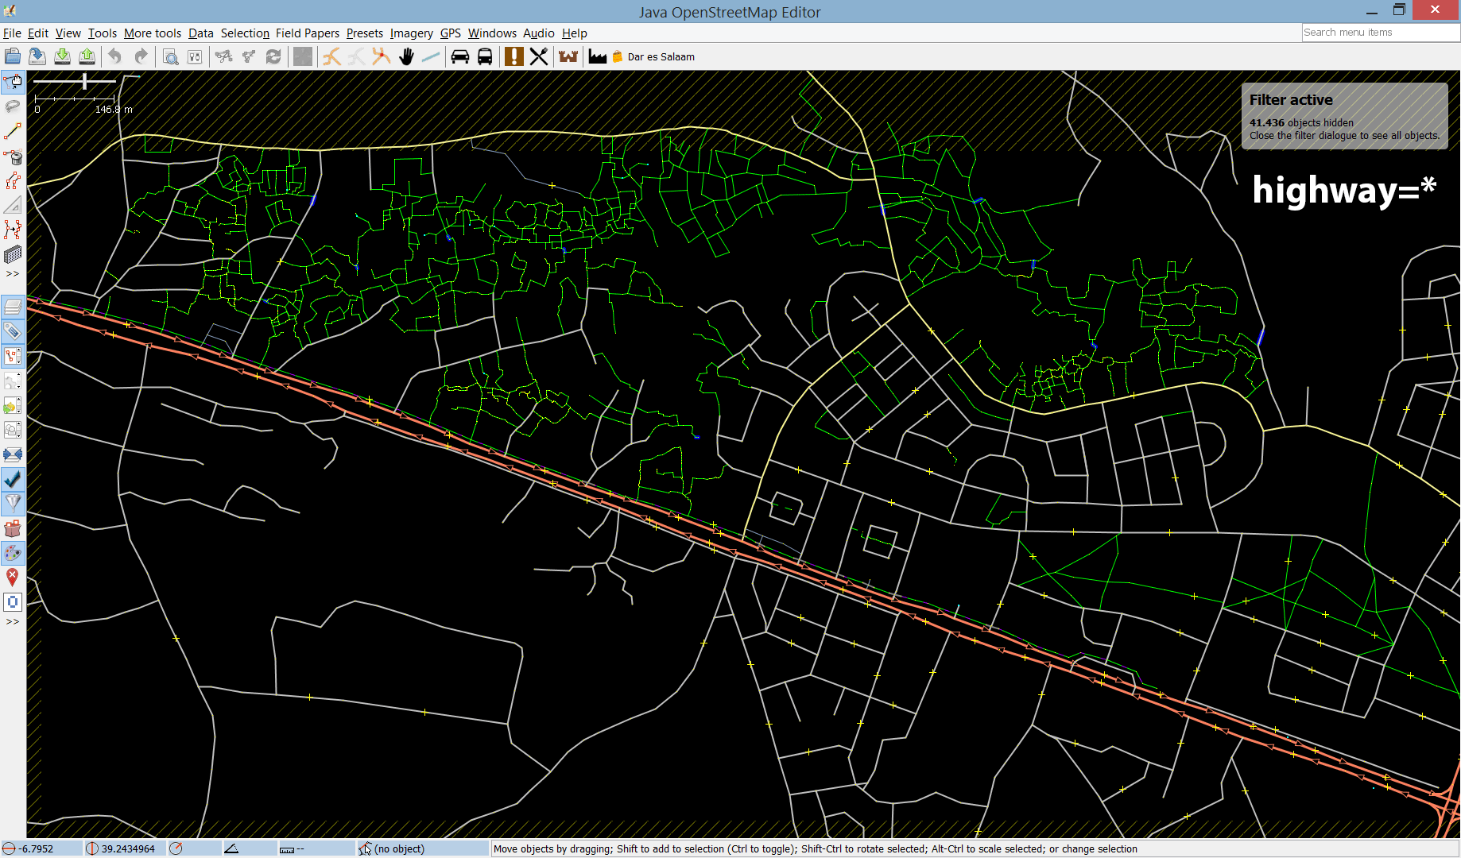
Gaps in the road network?

Slide 28
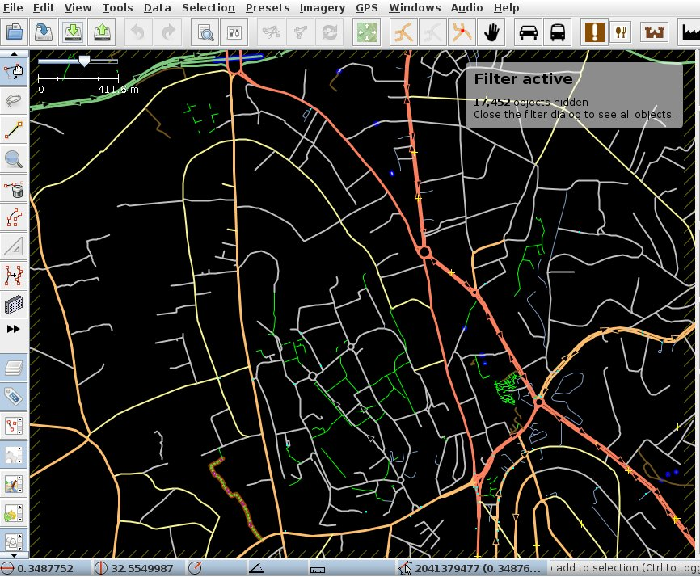
Gaps in the road network?

Slide 29
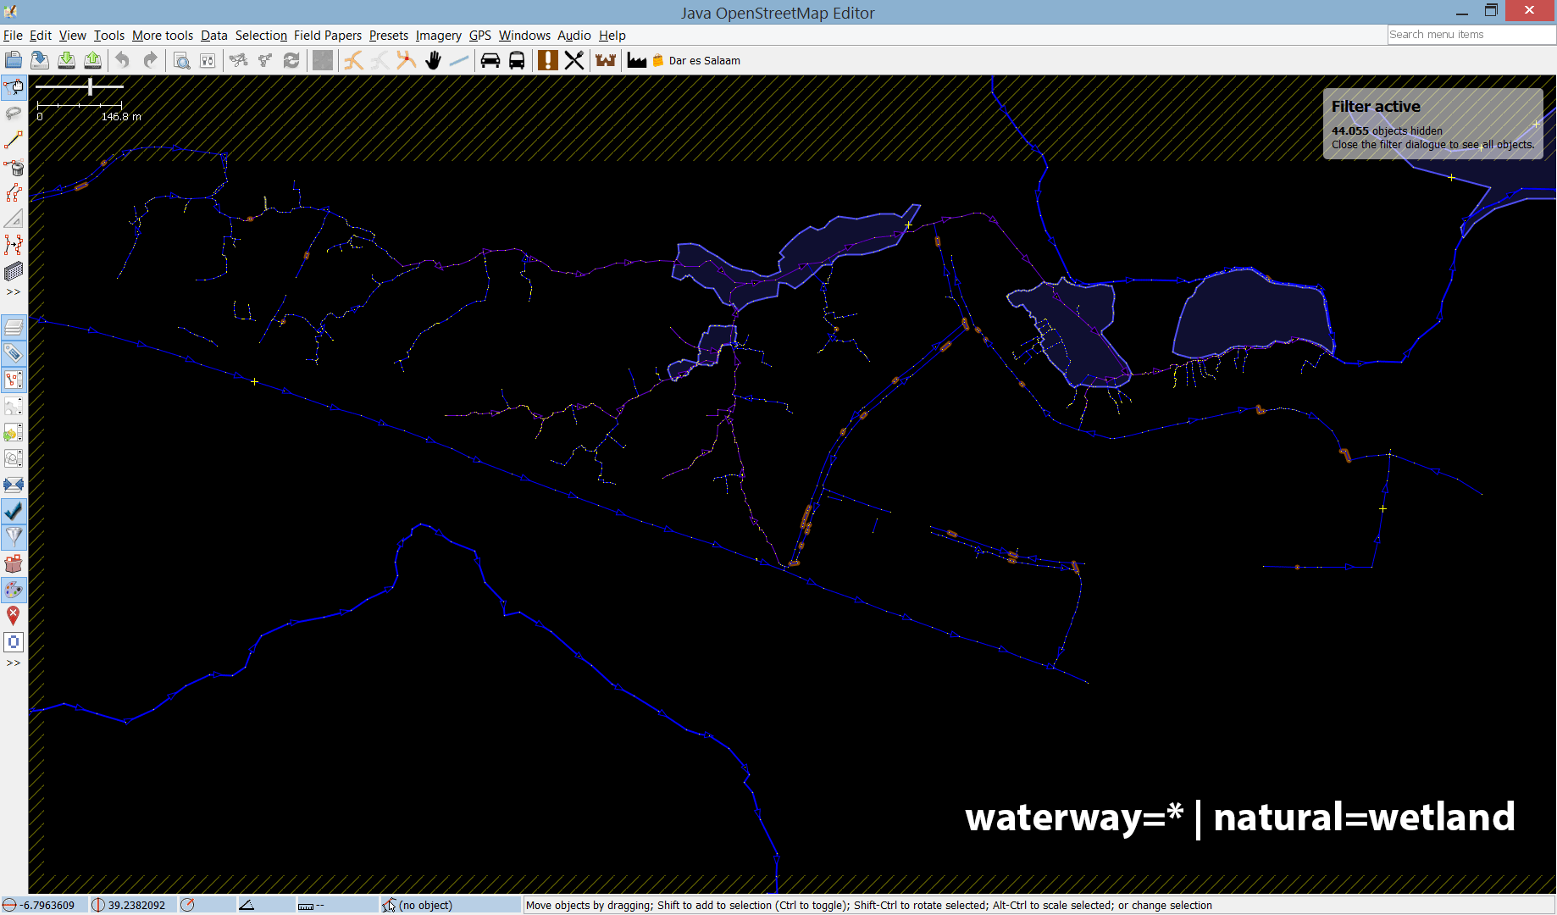
Gaps in the drainage network?

Slide 30
Gaps in the drainage network?

Slide 31
References
http://docs.inasafe.org/en/training/old-training/intermediate/osm/302-quality-assurance.html
https://www.mapbox.com/blog/2012-08-15-using-filters-josm/
http://docs.inasafe.org/en/training/osm/Chapter-08-conflict-resolution-in-osm.html

